Slide 1
Circular Pie ER Diagrams

Slide 2
Team 5 : Circular Pie
List of Entities
Entity Name | Entity Primary Attributes
Customer | customer_id, first_name last_name, email, phone_number Address, zip_code
Order | order_id, restaurant_id, coupon_code, customer_id, order_date, order_status, total_price, special_intructions
Pizza | pizza_id, pizza_size, protein, toppings, order_id
Delivery | delivery_id, order_id, driver_name, driver_phone_number, delivery_address, zip_code, delivery_status
Payment | payment_id, order_id, payment_date, payment_method, amount
Partner_restaurant | restaurant_id, restaurant_name, address, phone_number, zip_code, email
Advertiser | advertiser_id, company_name, contact_person_name, contact_person_phone_number, contact_person_email, ad_start_date, ad_end_date, ad_cost, paid, payment_reference_no
Coupon | coupon_code, discount, max_amount, expiry_date
Zone_map | zip_code, restaurant_id, restaurant_zip_code

Slide 3
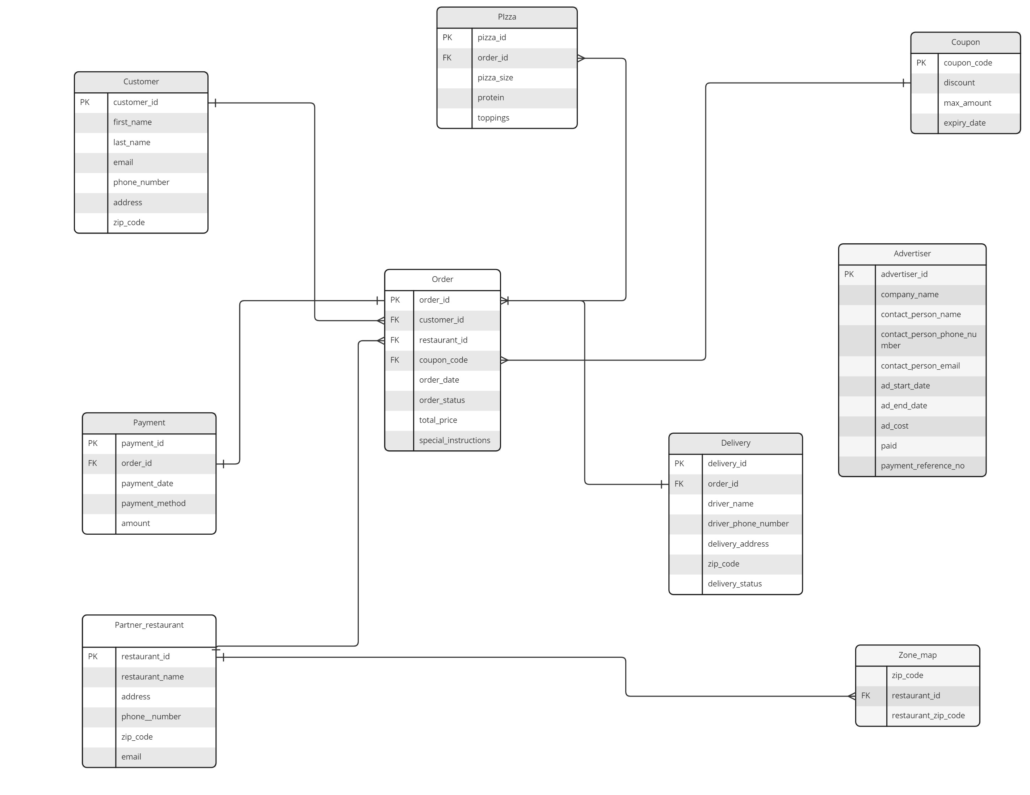
Team 5 : Circular Pie
Logical ER Diagram

